Slide 1

FWI Predictor
A machine learning model to predict Fire Weather Index and enable proactive wildfire risk management

Slide 2
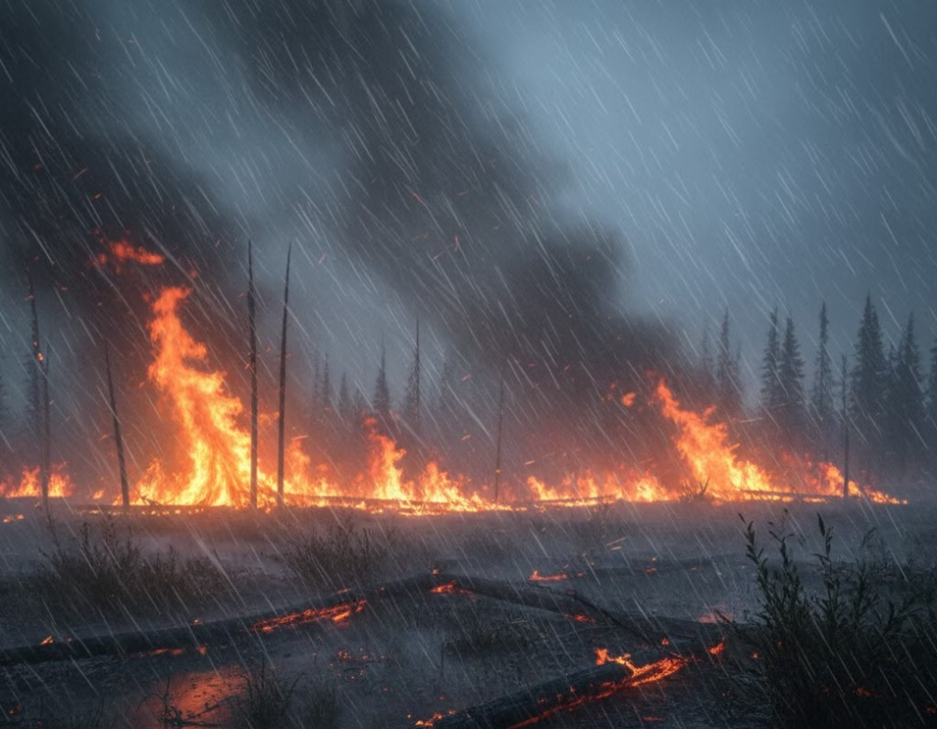
The Challenge
Wildfires pose a significant threat to ecosystems, human life, and property worldwide. The Fire Weather Index (FWI) is a crucial tool used by meteorological and environmental agencies to estimate wildfire potential.
This project builds a machine learning model that predicts FWI based on real-time environmental data, supporting early warning systems for wildfire hazards.

Slide 3


Project Workflow
Feature Engineering and Scaling
Data Collection
Data Preprocessing
Creating new features from existing data and scaling numerical features to improve model performance.
Cleaning raw data, handling missing values, outlier detection, and ensuring data consistency.
Gathering real-time environmental data including temperature, humidity, wind speed, precipitation, and historical FWI records.
Model Saving
Model Evaluation and Optimization
Serializing the trained model for future use and deployment.
Model Training using Ridge Regression
Assessing model performance using metrics like RMSE and R-squared, and fine-tuning hyperparameters for better accuracy.
Training the machine learning model using Ridge Regression to predict the Fire Weather Index.
Deployment via Flask App
Integrating the trained model into a Flask application for real-time wildfire potential prediction.

Slide 4
Data Collection & Exploration
Data Collection
Data Preprocessing
Exploration
Temperature, Relative Humidity, Wind Speed
Handled missing values
Visualised distributions
Outlier detection via boxplots
Correlation matrix analysis
Rain, FFMC, DMC, ISI metrics
Encoded categorical regions
Feature relationships mapped
Regional data included

Slide 5
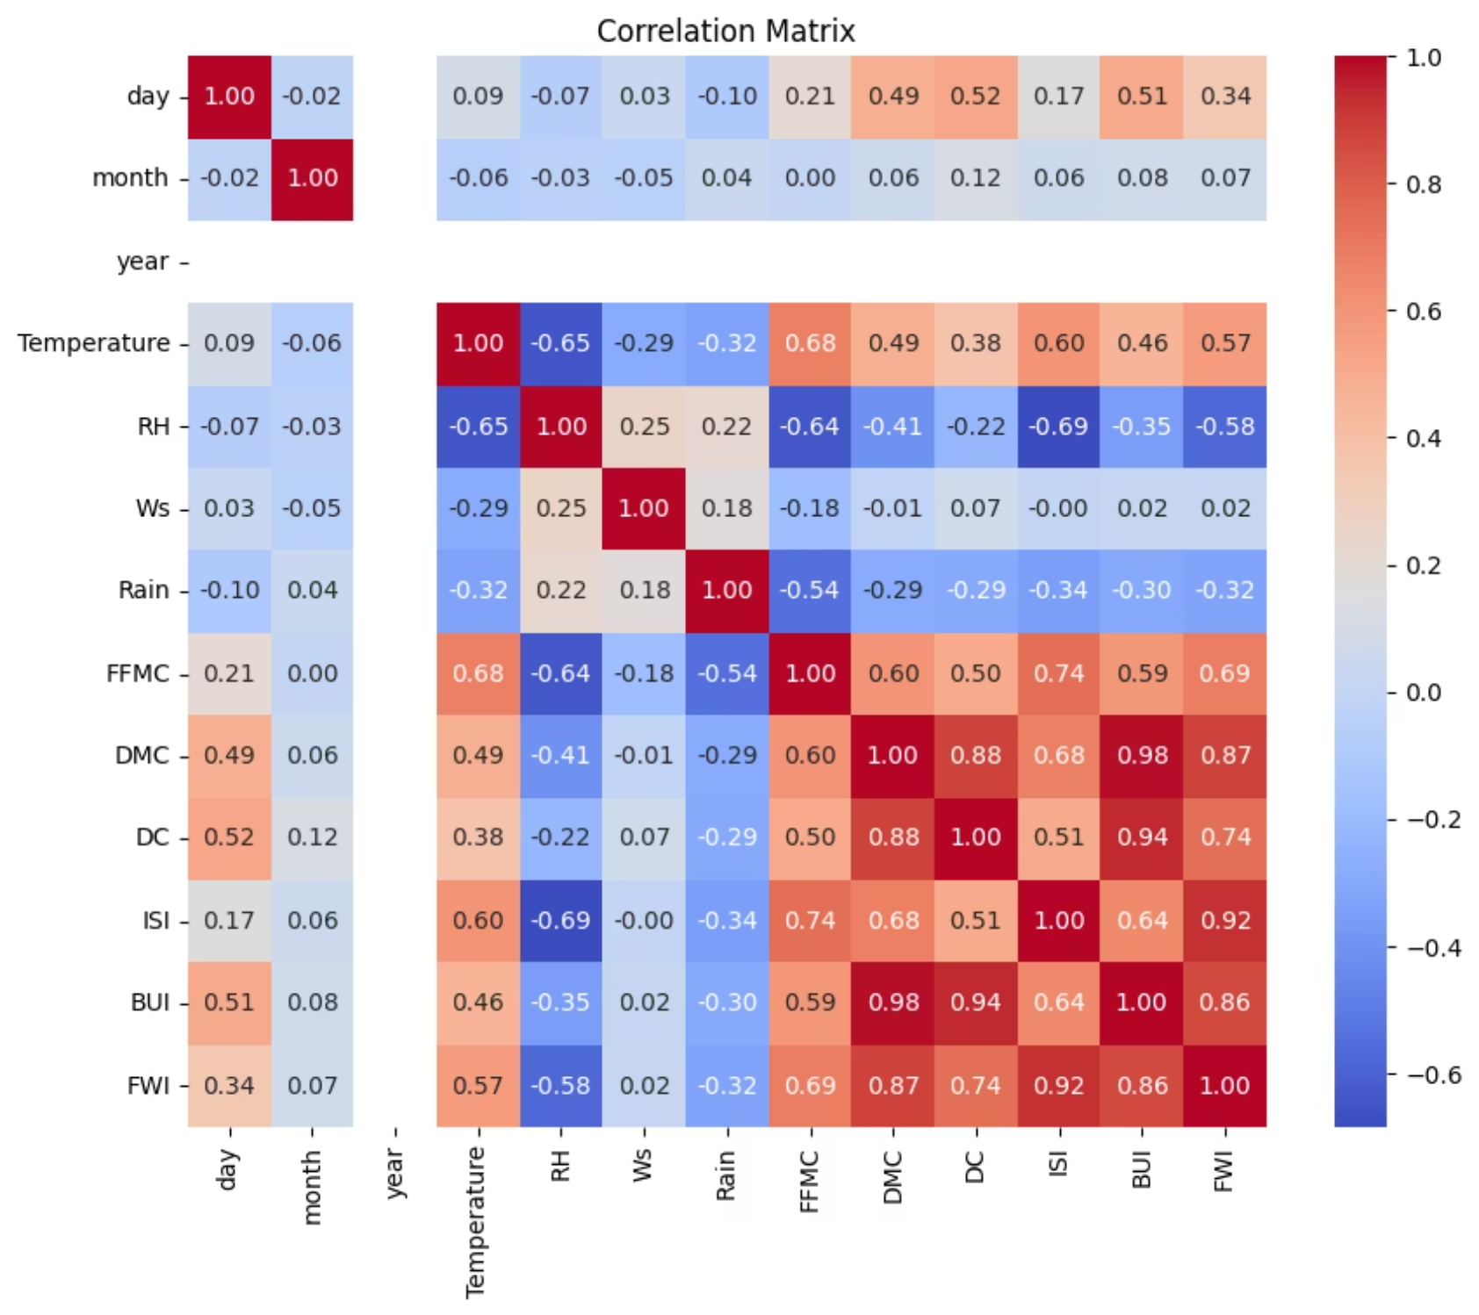
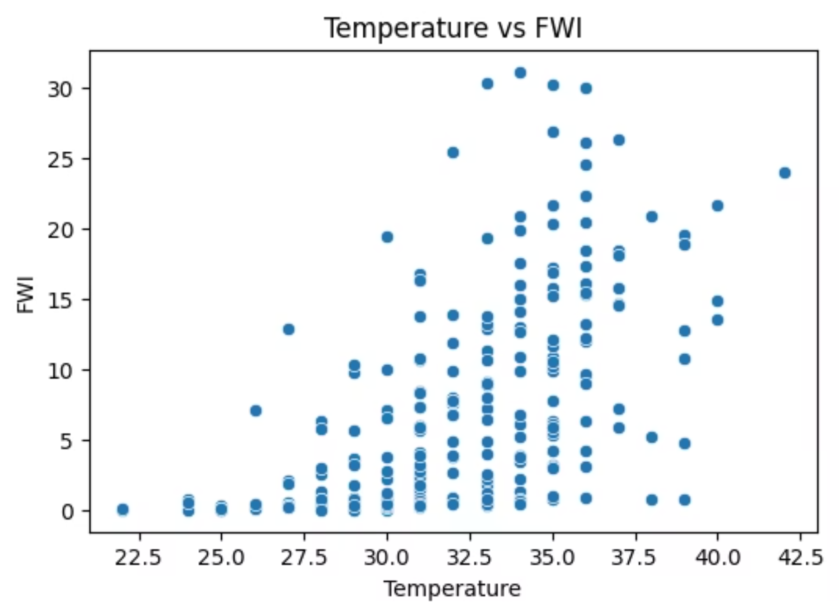
Temperature vs FWI: A scatterplot showed a positive trend: as temperature increases, FWI tends to increase.
Correlation Matrix Heatmap. This map shows how strongly every feature relates to every other feature

Slide 6




Feature Engineering & Scaling
Feature Selection
Normalisation
Data Split
Identified key variables most correlated with FWI target .
Applied StandardScaler for consistent feature scaling
Separated training(80%) and testing (20%) sets for model validation
Selected features based on correlation: ['Temperature', 'RH', 'Ws', 'Rain', 'FFMC', 'DMC', 'DC', 'ISI', 'BUI', 'FWI']
The scaler was saved as a .pkl file to ensure consistency between training and deployment environments

Slide 7
Model Training - Ridge Regression Model
Why Ridge Regression?
Ridge Regression was selected to handle multicollinearity in environmental input data, providing robust predictions even when features are correlated.
01
02
03
Alpha Tuning
Training
Model Saving
Balanced bias-variance tradeoff
Evaluated performance metrics
Saved as ridge.pkl for deployment
Best alpha: 0.5

Slide 8



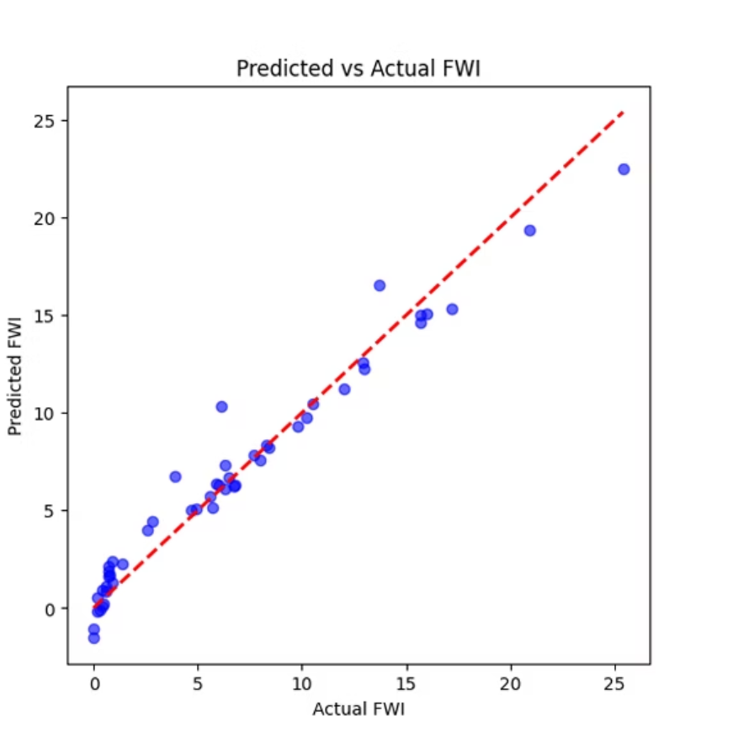
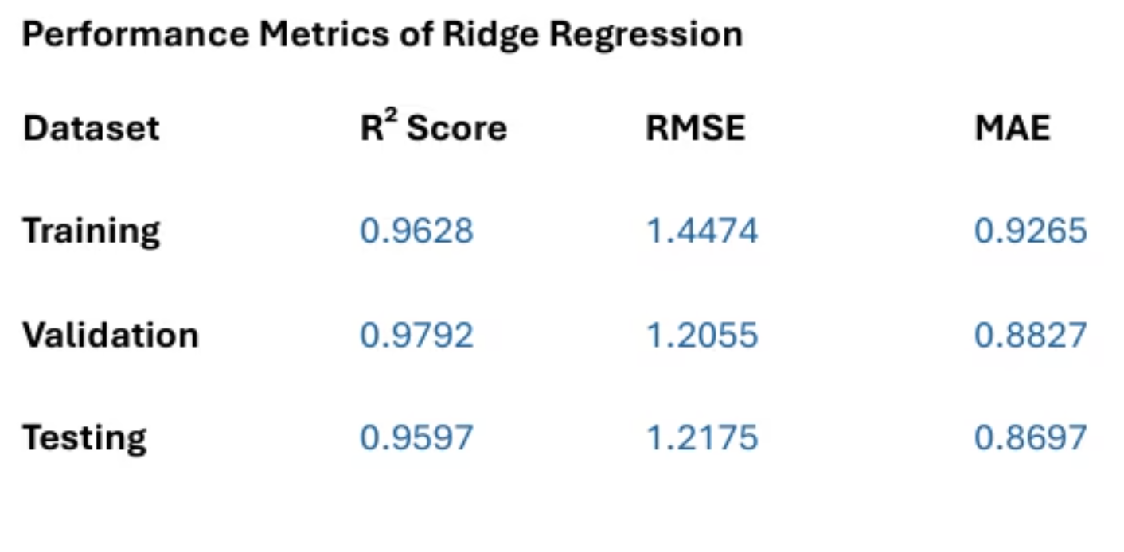
Model Performance
Mean Absolute Error
Root Mean Squared Error
R² Score
Measured average prediction accuracy across all test samples
Penalised large prediction errors to ensure reliability
Assessed variance explanation and model fit quality
Predicted vs actual values were plotted to visualize performance

Slide 9




Flask Web Application
User Interface
App Structure
Developed index.html for input form with all feature fields
Created Flask app with app.py as main application file
Results Display
Prediction Engine
Created home.html to show predicted FWI value to users
Loaded ridge.pkl and scaler.pkl for real-time predictions

Slide 10
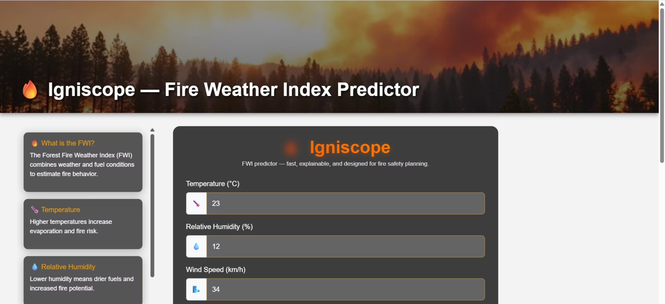
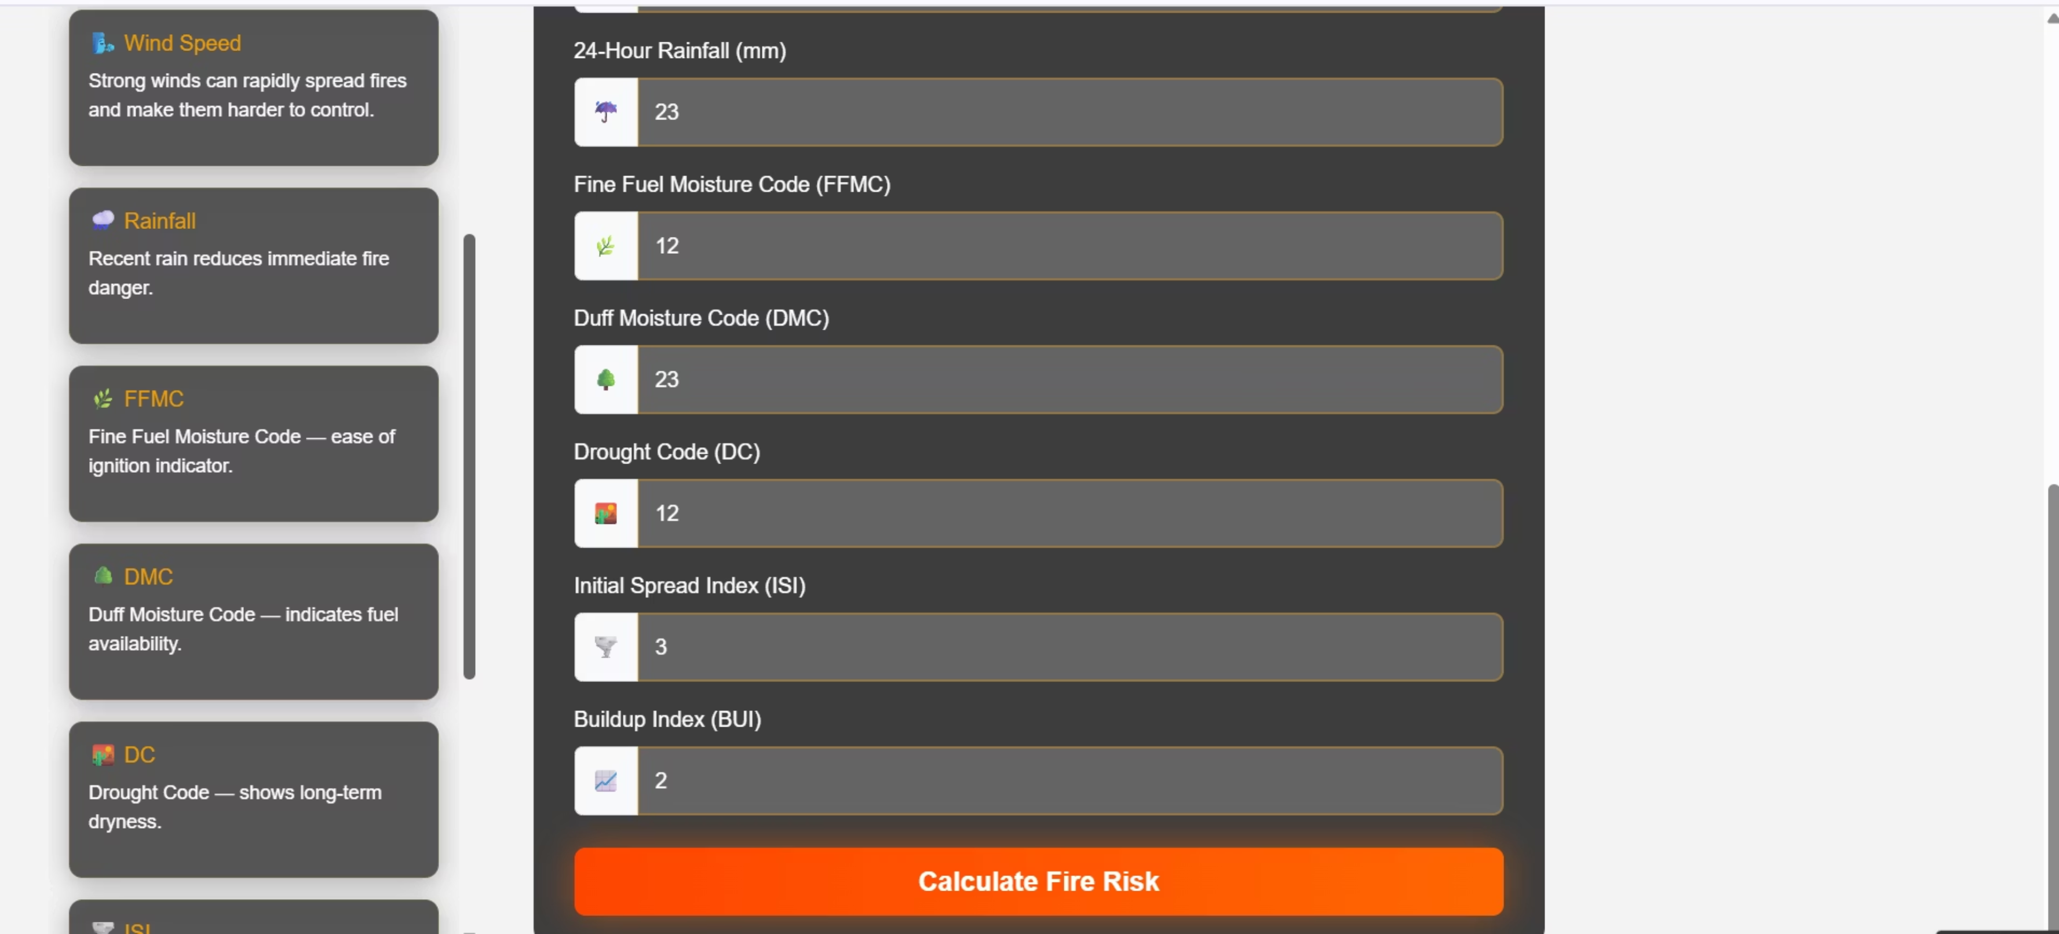
User Interface

Slide 11
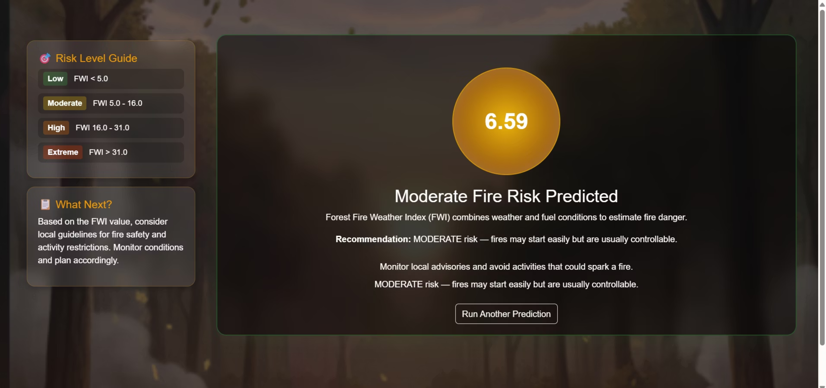
Sample Output

Slide 12
Impact & Future
Enabling Proactive Risk Management
The FWI Predictor provides meteorological and environmental agencies with a powerful tool for early wildfire detection and risk assessment.
Real-time predictions
Early warning systems
Scalable deployment
Based on current environmental conditions
Support for proactive wildfire management
Web-based interface for widespread access

Slide 13
Conclusion
The FWI Predictor project involved a comprehensive workflow, from data collection and model development to deployment as a user-friendly web application, ensuring a robust and reliable system for critical insights.
Its technical success is built on a high-performing Ridge Regression model for accurate, real-time Fire Weather Index (FWI) forecasts, integrated into a scalable Flask web application for broad accessibility and real-time operational capabilities.
The FWI Predictor delivers significant real-world impact by empowering meteorological and environmental agencies with accurate, real-time forecasts. This enables proactive wildfire management, supporting early warning systems, resource allocation, and critical decisions to safeguard communities and ecosystems.

